Slide 1
Employee Salary Prediction
Presented By:
ROOHI AFSHA
LOYOLA ACADEMY

Slide 2
OUTLINE
Problem Statement
System Development Approach
Algorithm & Deployment
Result
Conclusion
Future Scope
References

Slide 3
Problem Statement
This project aims to build a machine learning model to predict employee salaries based on various features such as job title, years of experience, education level, and industry. The main objective is to support HR professionals in determining fair and competitive compensation for employees. Accurate salary prediction helps in resource planning, avoiding under or over-compensation, and reducing pay disparities.

Slide 4
System Approach
System Requirements: Python 3.x, Jupyter Notebook
Libraries Used: pandas, numpy, matplotlib, seaborn, scikit-learn
Data Source: Public dataset from Kaggle or similar platform
Data Preprocessing: Handling missing values, encoding categorical variables, feature selection
Modelling Approach: Regression models including Linear Regression and Random Forest Regressor

Slide 5
Algorithm & Deployment
Data Collection and Cleaning
The dataset was obtained from a reliable source (e.g., Kaggle).
Initial inspection was done using .head(), .info(), and .describe() functions.
Missing values were identified and handled by either filling with mean/median or dropping rows/columns as appropriate.
Duplicates were removed to ensure data integrity.

Slide 6
Algorithm & Deployment
Exploratory Data Analysis (EDA)
Visualizations such as histograms, boxplots, and pairplots were created using Matplotlib and Seaborn to understand the distribution of salary and related features.
Correlation analysis was performed using a heatmap to detect relationships between numerical variables.
Outliers were detected and handled using interquartile range (IQR) or visual inspection.

Slide 7
Algorithm & Deployment
Feature Engineering
Categorical variables such as job title, education level, and industry were encoded using Label Encoding or One-Hot Encoding.
Numerical features were scaled using StandardScaler to bring them to a uniform range.
New features such as “experience bins” or “education level score” were optionally created to improve model performance.

Slide 8
Algorithm & Deployment
Model Selection
Two regression algorithms were selected: Logistic Regression and Random Forest Regressor (for improved accuracy and non-linearity handling).
Data was split into training and testing.

Slide 9
Algorithm & Deployment
Model Training and Evaluation
Models were trained using the training set.
Prediction were made on the test set.

Slide 10
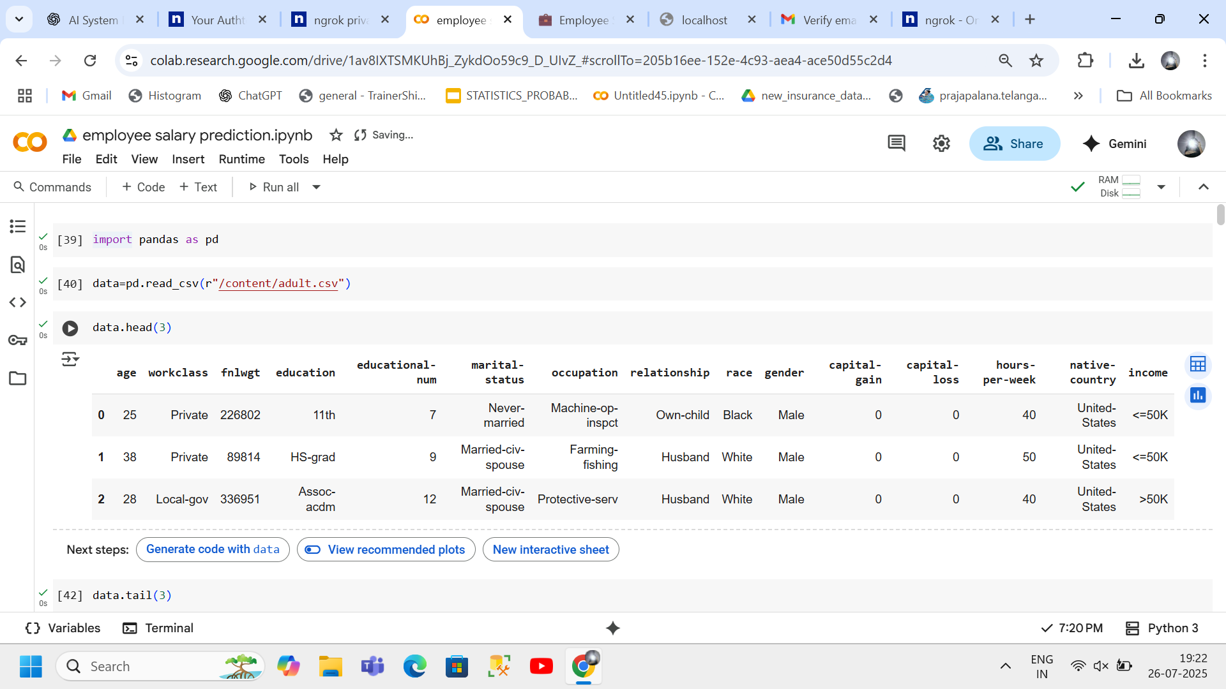
Result

Slide 11
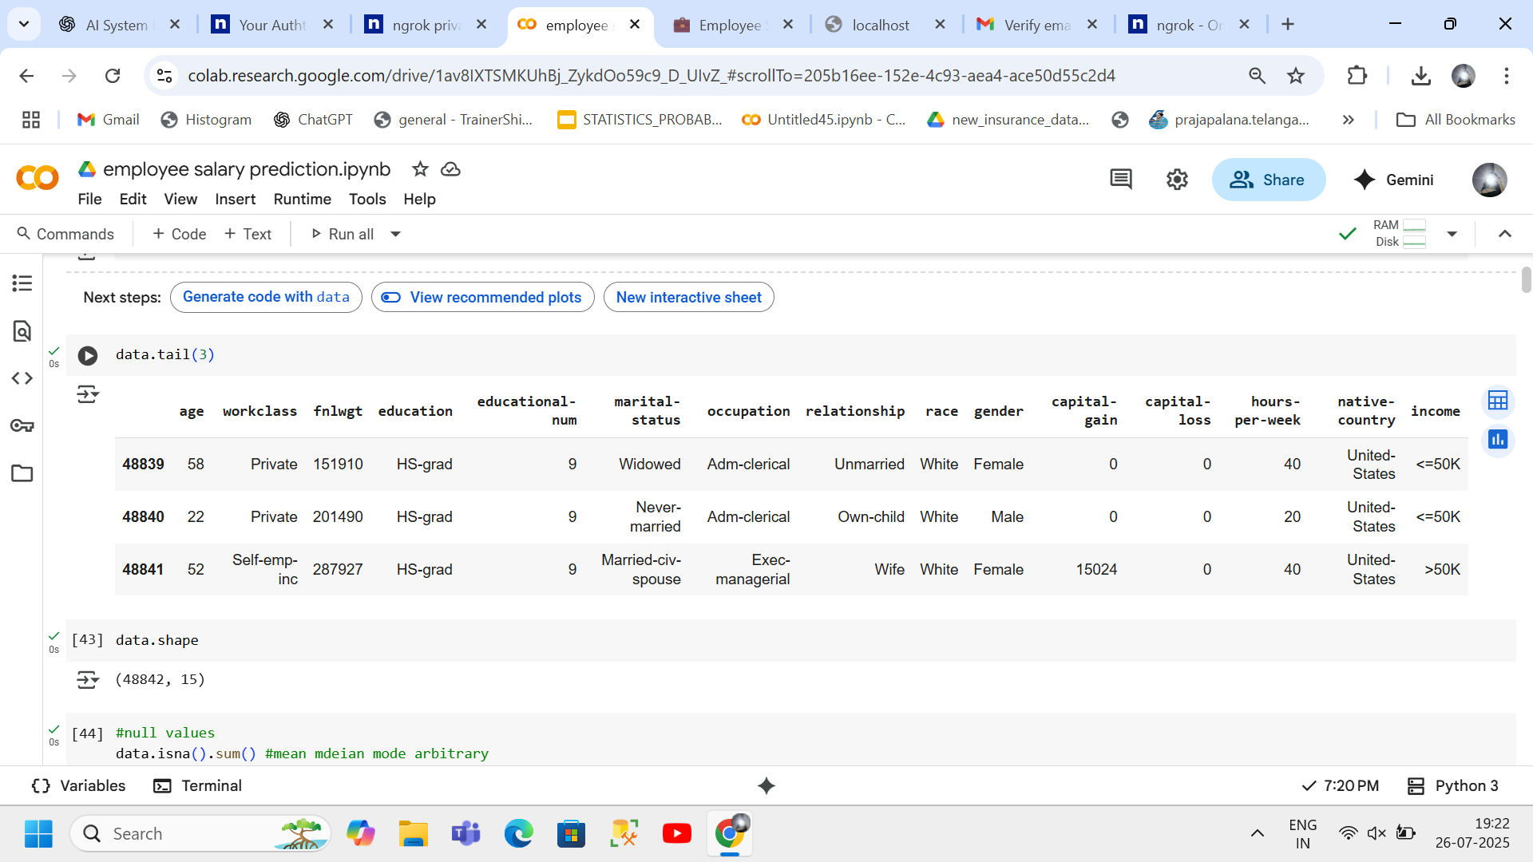
Result

Slide 12
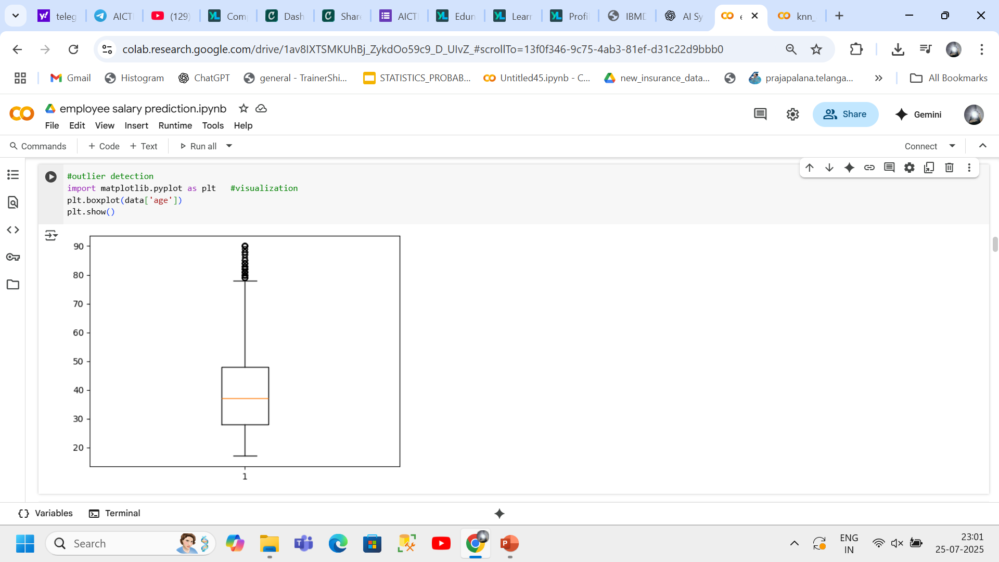
Result

Slide 13
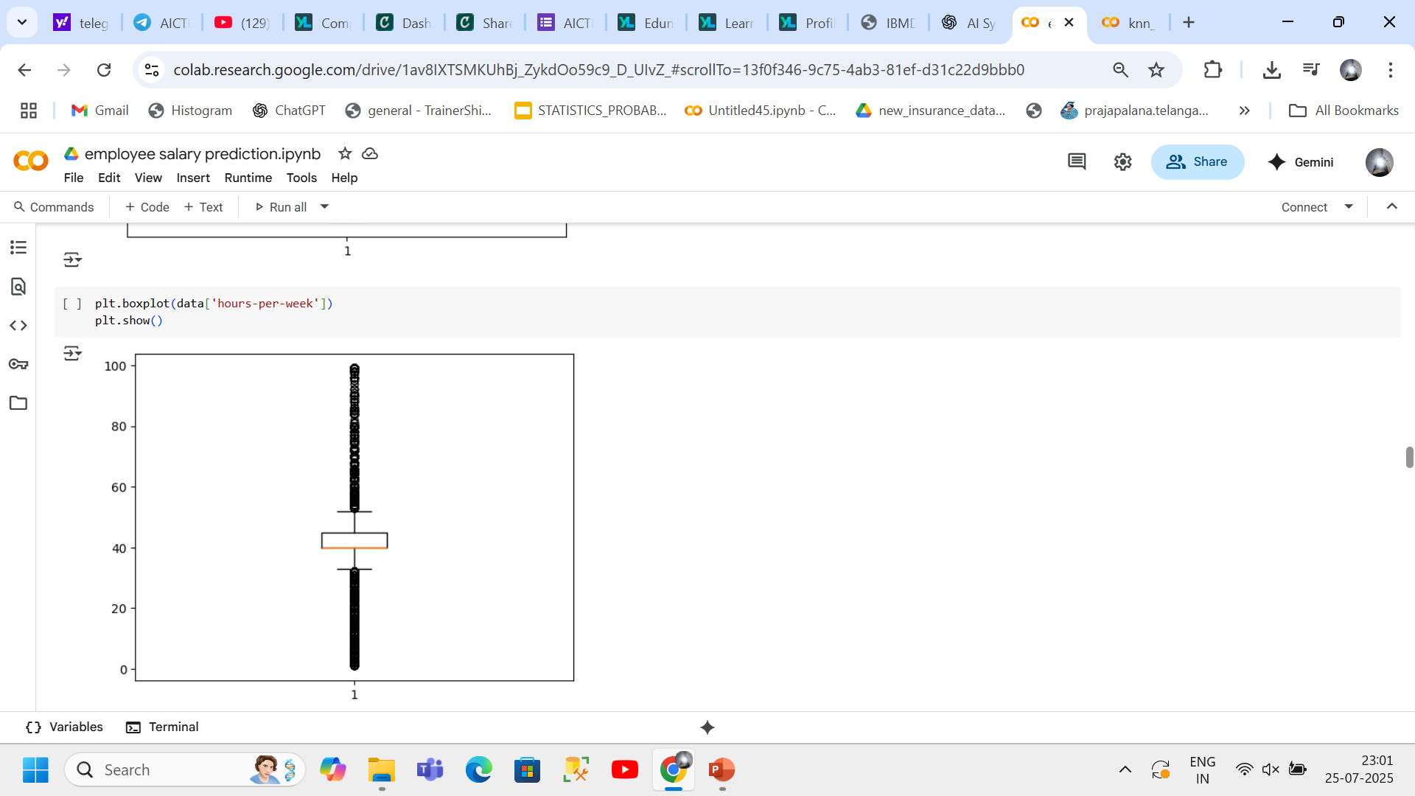
Result

Slide 14
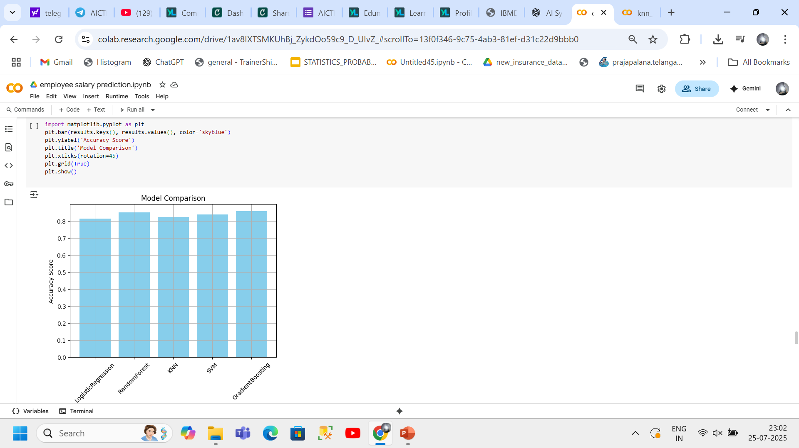
Result

Slide 15
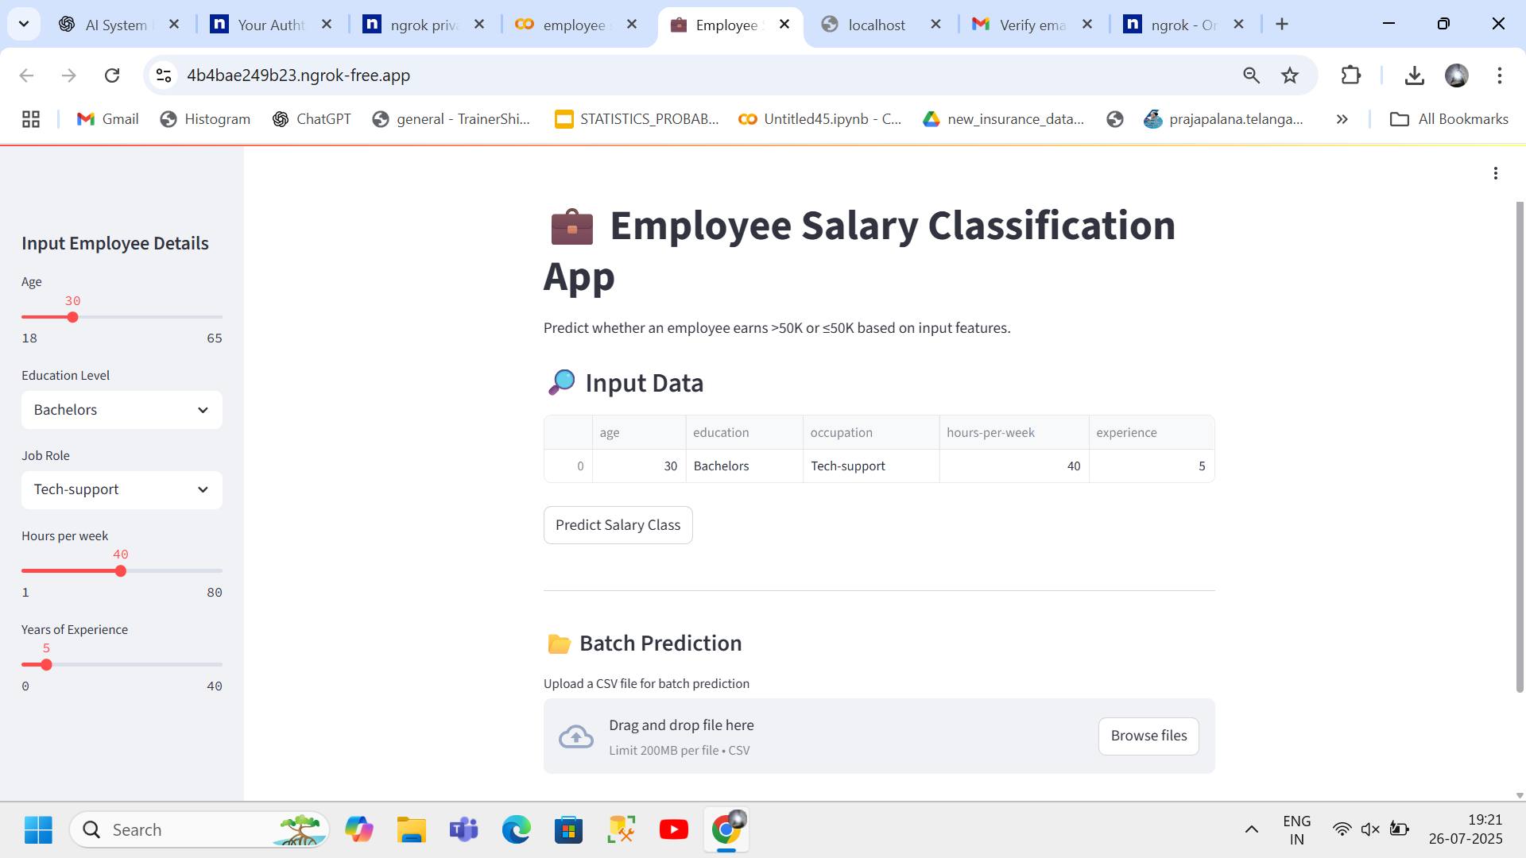
Result

Slide 16
Result
https://github.com/ROOHIAFSHA/Employee-Salary-Prediction-.git
Github link

Slide 17
Conclusion
The model developed successfully predicts employee salaries based on multiple input features. Key challenges included dealing with missing values and optimizing model parameters. Future improvements could include using more diverse data and deploying the model as a web app.

Slide 18
Future scope
Use a larger, more diverse dataset
Incorporate more features such as geographic location, skills, certifications
Develop a web interface for salary prediction
Integrate with HR management systems

Slide 19
References
Scikit-learnDocumentation: https://scikit-learn.org/stable/documentation.html
Python Data Science Handbook by Jake VanderPlas: https://jakevdp.github.io/PythonDataScienceHandbook/
IBM SkillsBuild Program: https://skillsbuild.org
Pandas Documentation: https://pandas.pydata.org/docs/
Matplotlib Documentation: https://matplotlib.org/stable/contents.html/

Slide 20
THANK YOU

